Slide 1

Chrome Extension
Made by khaleel esa

Slide 2
What is a Google Chrome Extension?
Google Chrome extensions are programs that can be installed into Chrome in order to change the browser's functionality
This includes adding new features to Chrome or modifying the existing behavior of the program itself to make it more convenient for the user.

Slide 3
Examples of the type of functionality that a Google Chrome extension can add to Chrome
Blocking ads from being displayed
Adding to do lists or notes to Chrome
Password management
Making it easier to copy text from a site
! Not all Chrome Extensions are beneficial there are malicious extensions out there that can push ads to your web or change your search provider, example extension called “search-NewTab” !

Slide 4

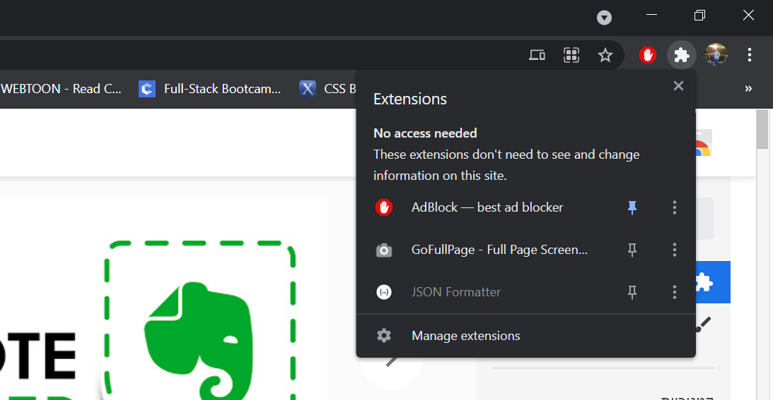
How to install and use new Extensions
Extensions can be installed from chrome web store
When you install an extension you can manage it from the extension tap in chrome at the top right corner of the page

Slide 5
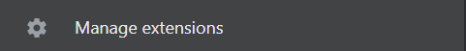
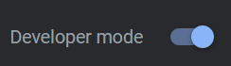
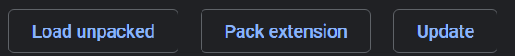

How to Create an Extension
To make a new extension you need to navigate to your extensions tap in chrome
click manage extensions in the bottom
you will get to your installed extensions page on the top right of the page click
you will get 3 new buttons press on load unpacked and you choose your extension folder that you made
that’s it your new extension has been added to chrome
You can get a simple extension folder that I made that changes the background of a new html page when the button clicked

Slide 6
Home Work
Its your turn to try and make a chrome extension
You need to crate an extension that:
each time you open a new tap in the browser it greets you and shows you the time with a your daily to-do list
start by making your html,css,js and the manifest.Json
Add your new extension to the browser and test it

